Slide 1
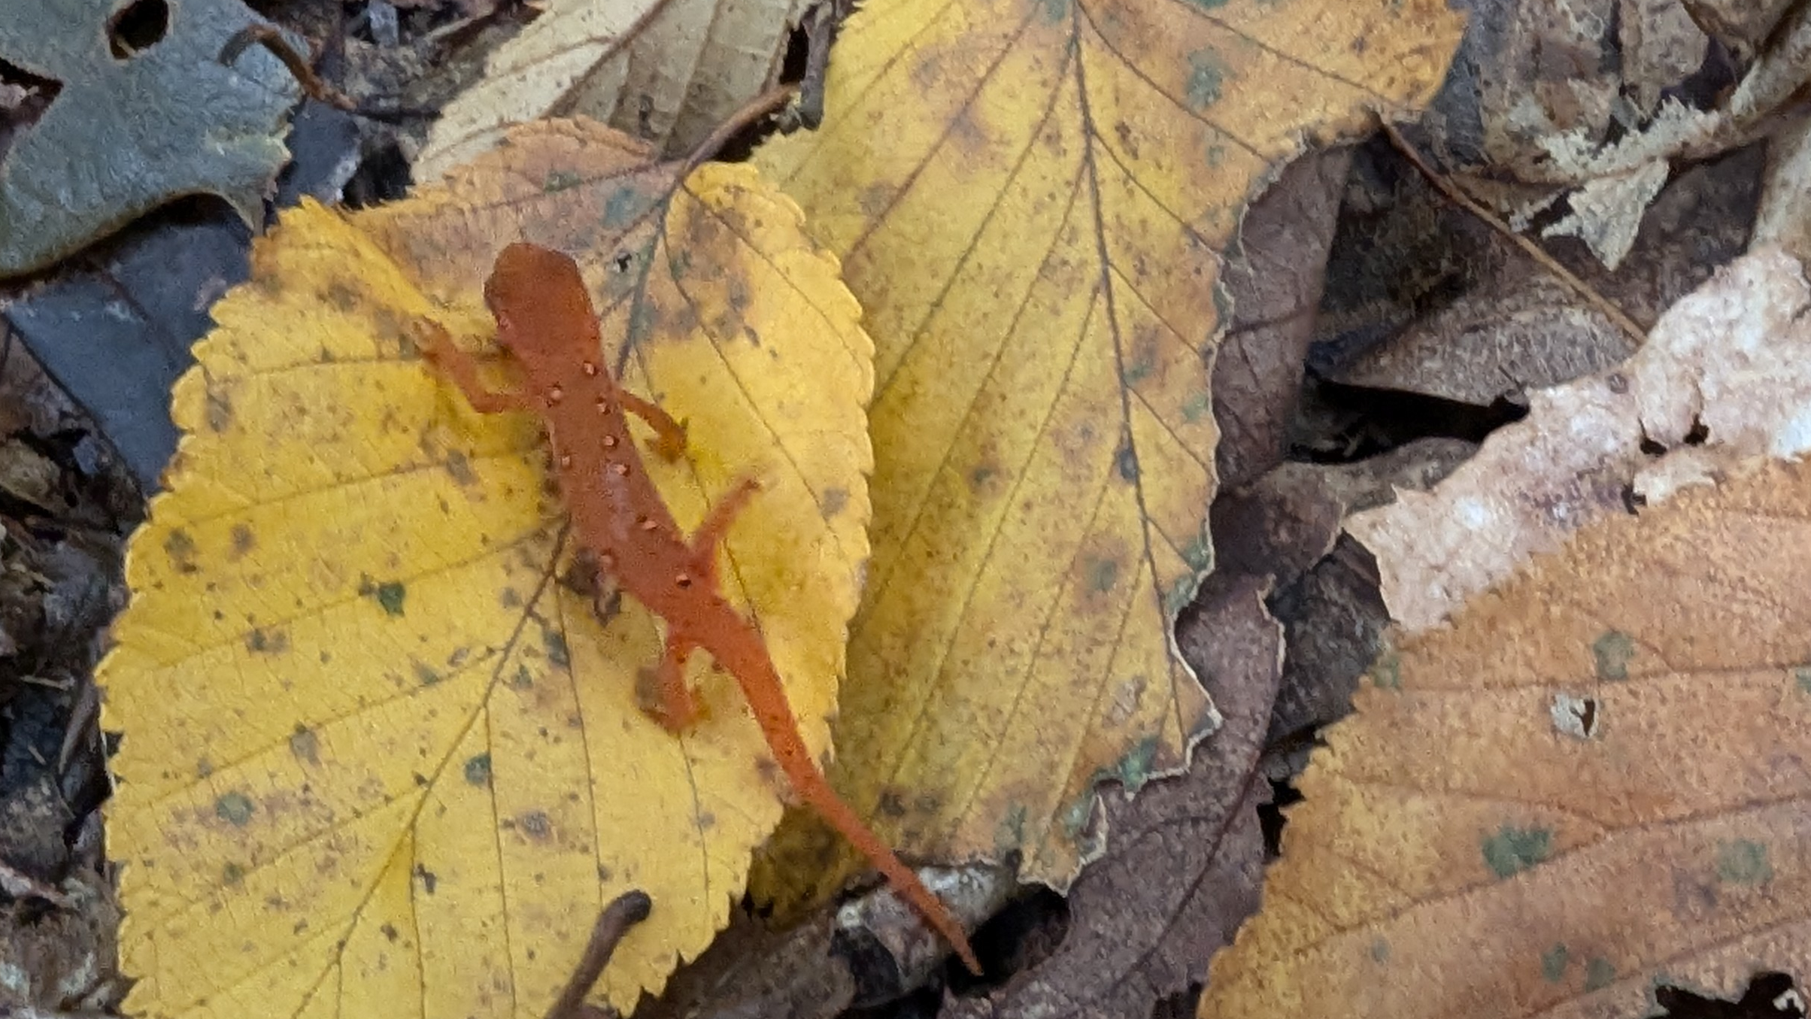
CISC-6100: Software Engineering
More technical design
Week 5 – September 30

Slide 2

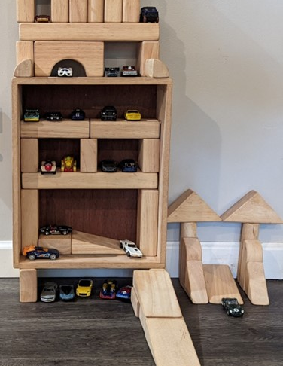
Outline for today’s class
Homework review
Sequence diagrams
Building up a class diagram
Activity diagrams
Core principles
Homework assignment

Slide 3
Homework review

Slide 4
Project management tools
Purpose
Planning
Fixed deadline
Fixed deliverable
Progress tracking
Scheduling
Issue tracking
Billing
Timecard generation
Communication
Examples
Zoho
Trello
Excel
Mindmap extensions,
Microsoft Project, ..
https://skillforge.com/microsoft-project-formatting-gantt-chart-summary-task/

Slide 5
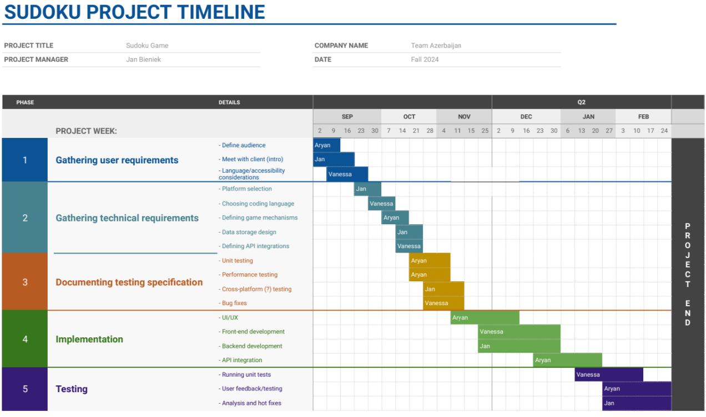
Project management: Google Sheets (Jan Bieniek)
https://skillforge.com/microsoft-project-formatting-gantt-chart-summary-task/

Slide 6
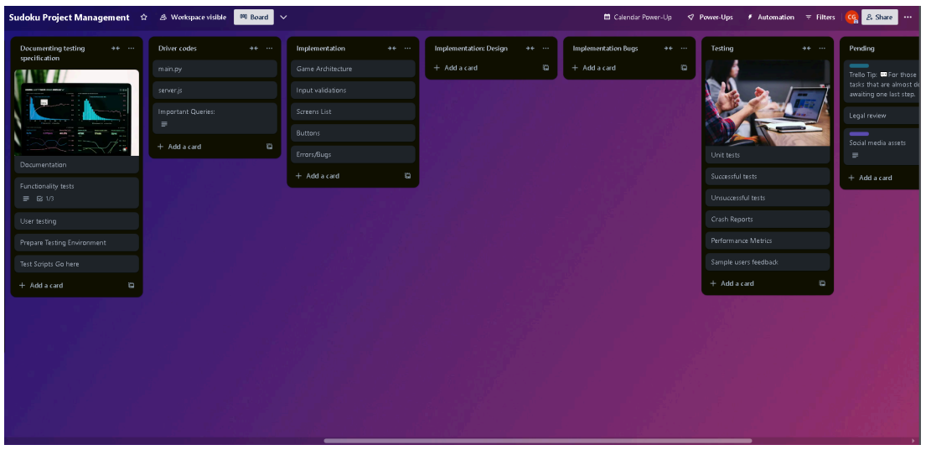
Project management: Trello (Gurpreet)
file:///C:/Users/foxxb/Downloads/Homework+4.pdf
https://skillforge.com/microsoft-project-formatting-gantt-chart-summary-task/

Slide 7
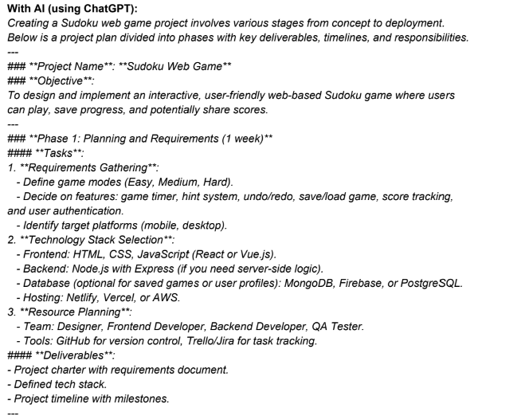
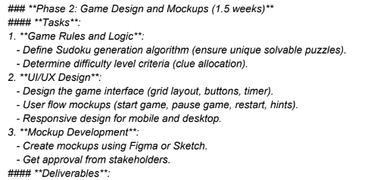
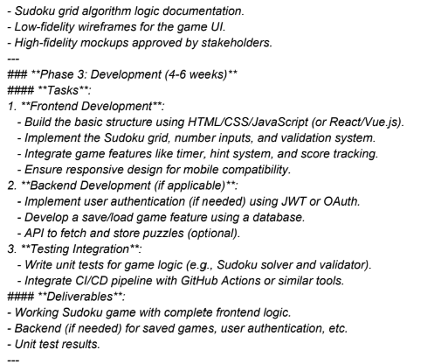
Project management: ChatGPT (Vanessa)
…
https://skillforge.com/microsoft-project-formatting-gantt-chart-summary-task/

Slide 8
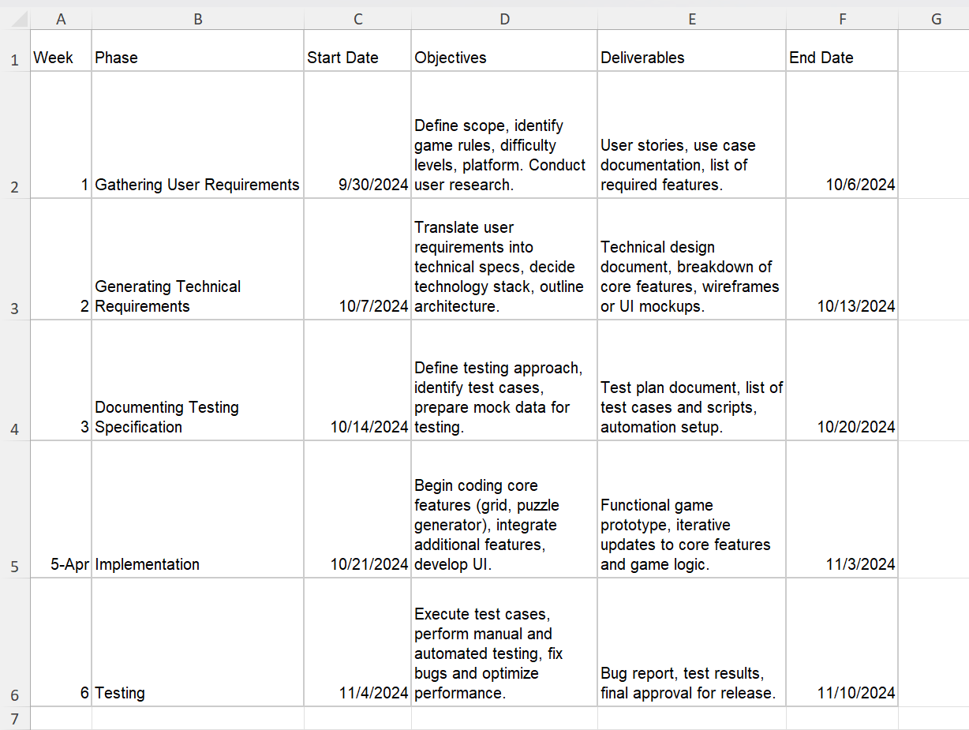
Project management: From AI generated CSV file (Mintesnot)

Slide 9
Sequence Diagrams

Slide 10
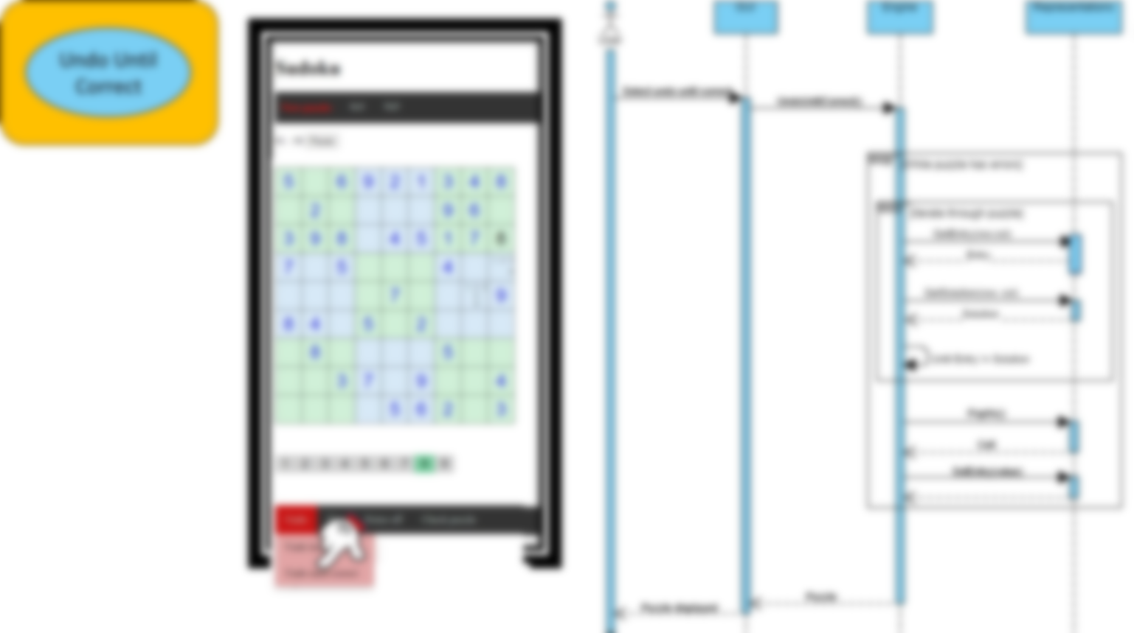
The following collection of selected sequence diagrams is now on Blackboard
Review all of them
Compare yours to the equivalent one
Ask questions!
You will need to create others as you do your projects

Slide 11
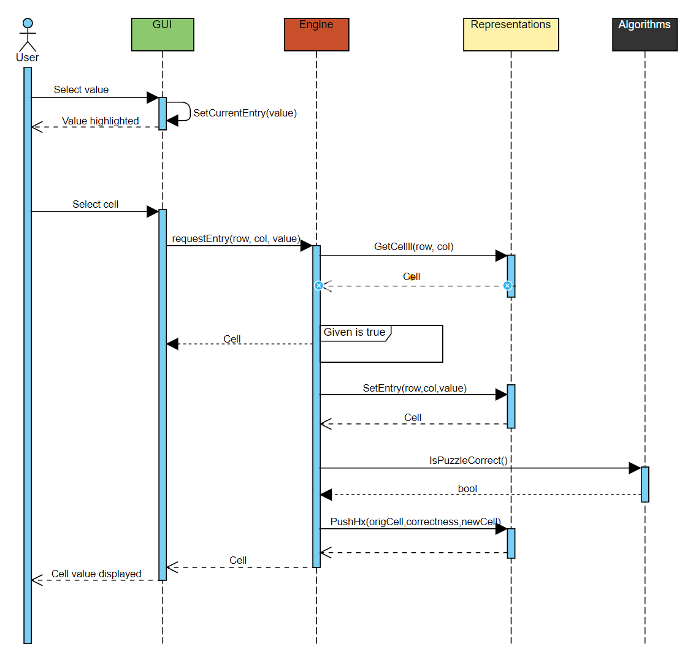
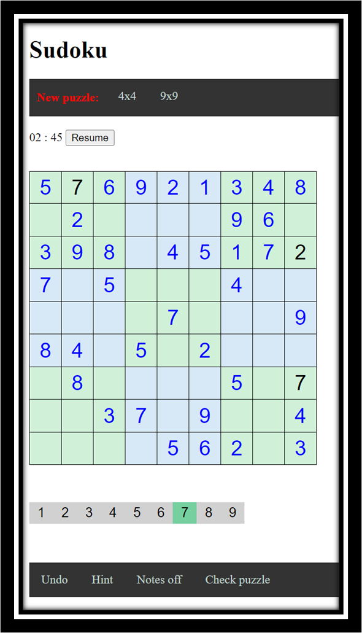

Set Cell Entry
Remember time goes from:
Left to right
Top to bottom
For now we will treat algorithms as black boxes
Missing exception: puzzle is complete and correct
Not clear: what ‘cell’ return will contain
Given is true
Entry is correct
Entry is incorrect

Slide 12
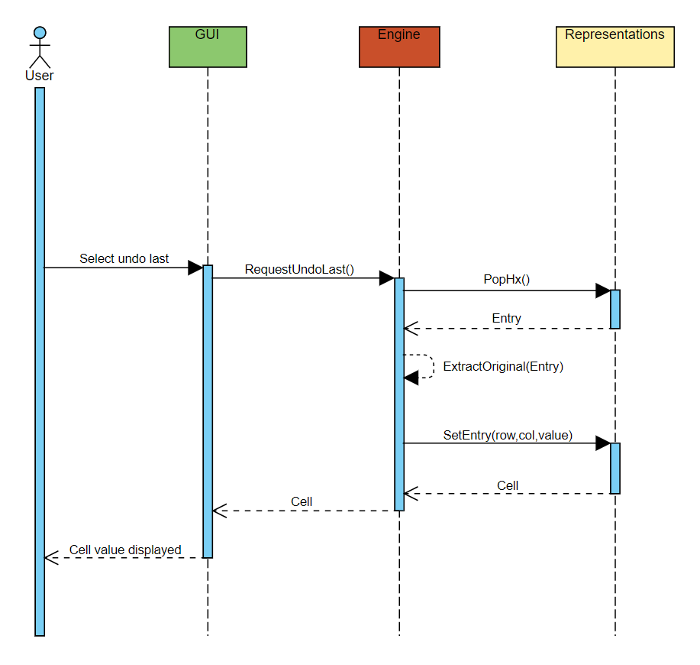
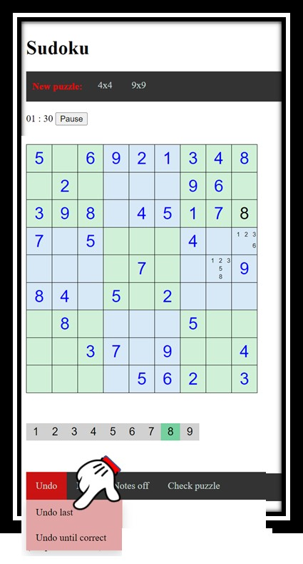
Undo Last Move(s)
Need to have an encoding of an ‘empty’ cell?
For project management need to keep a list of:
To do items
Items to discuss

Slide 13
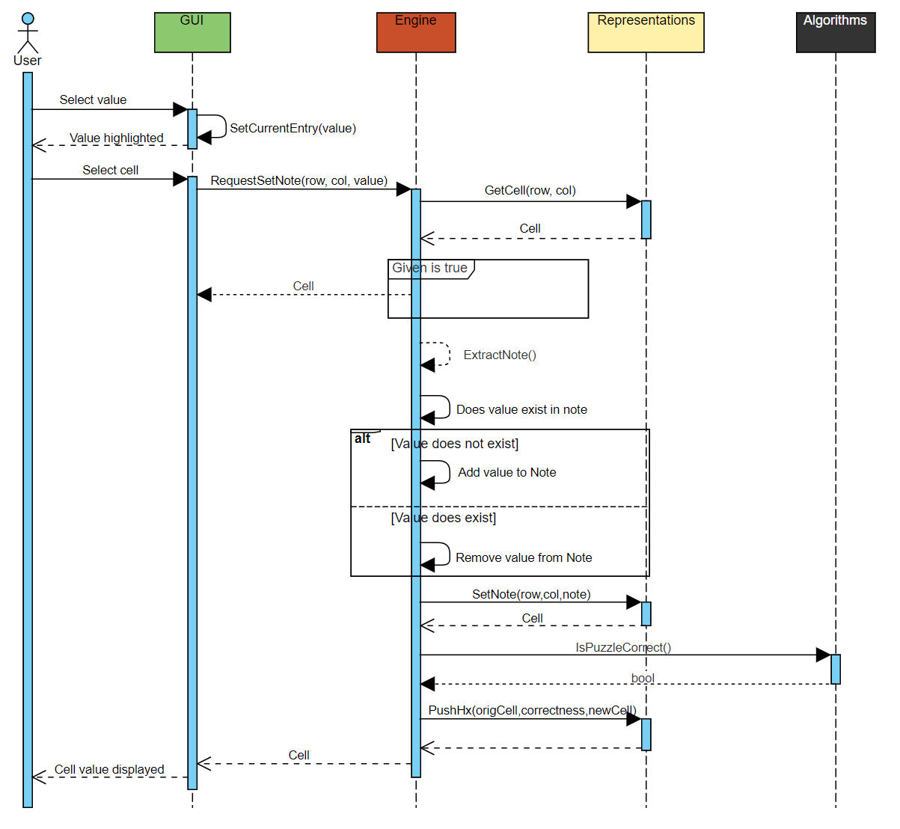
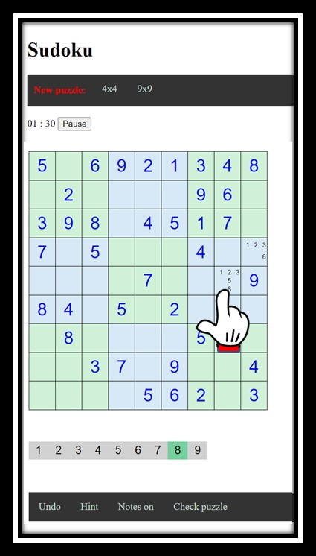
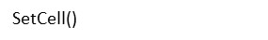
Set Note

Slide 14
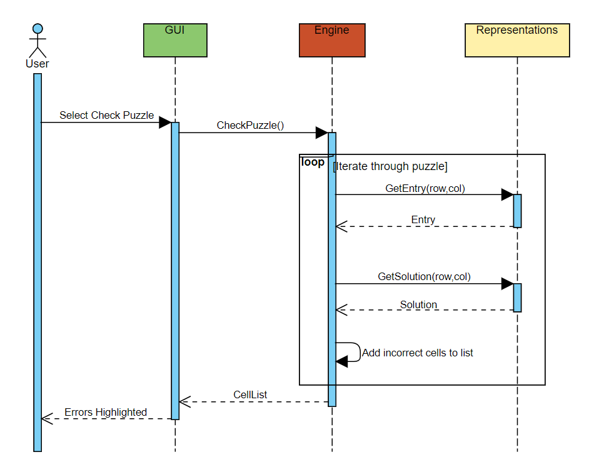
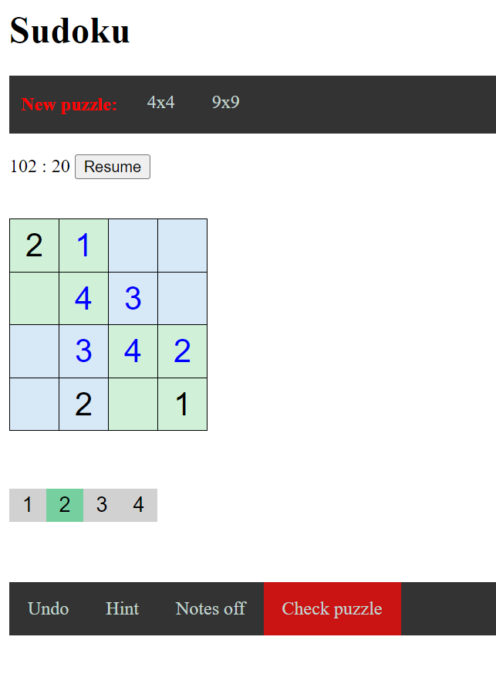
Check Puzzle

Slide 15
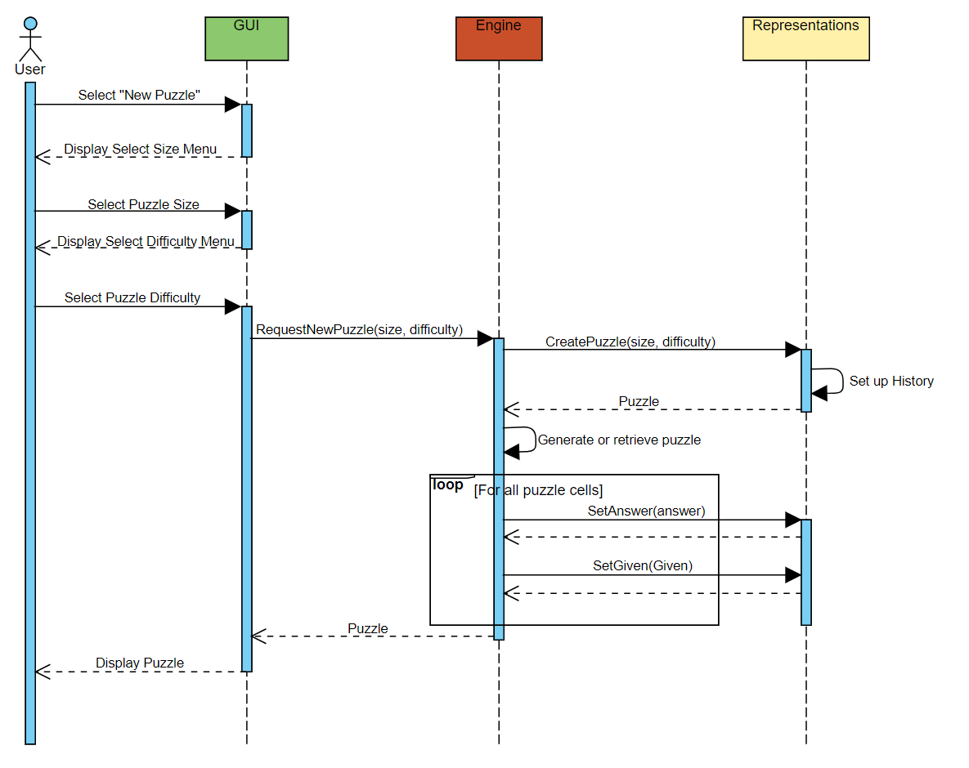
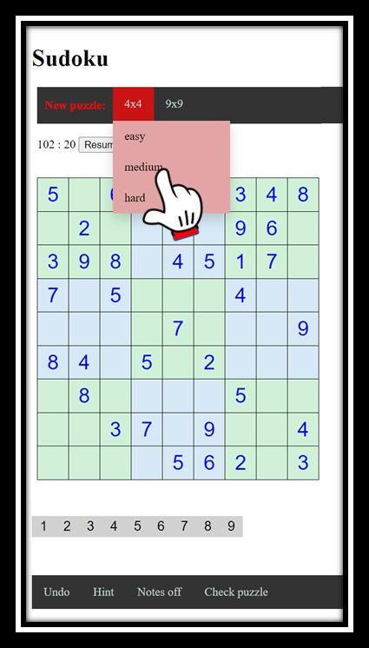
Select New Puzzle
Dependent on GUI
Need further work on ‘Generate or retrieve puzzle’:
Algorithm to create
Database to retrieve from

Slide 16
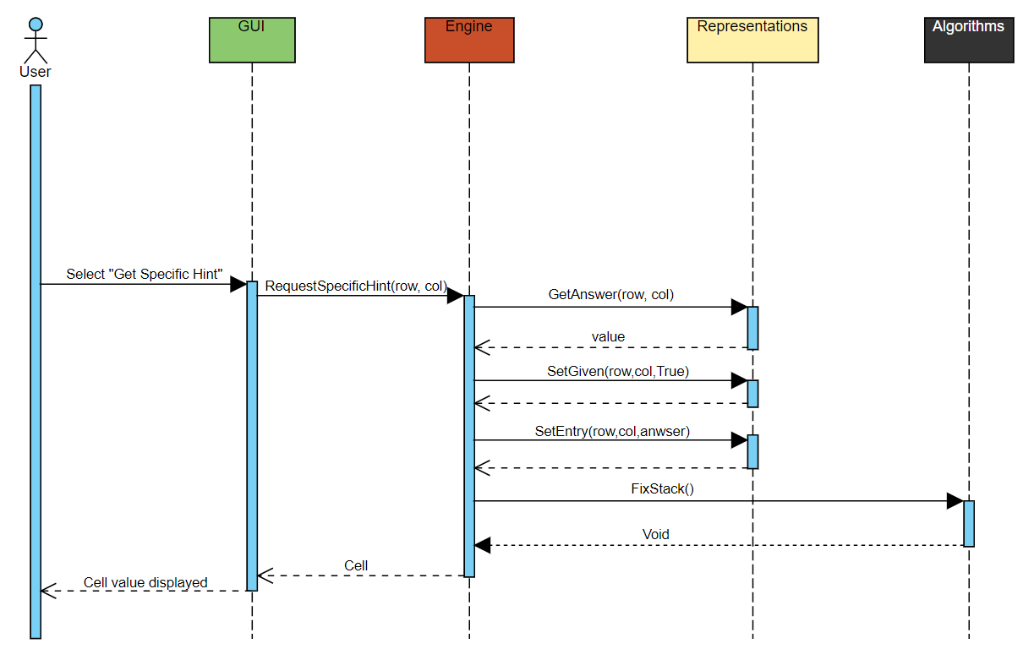
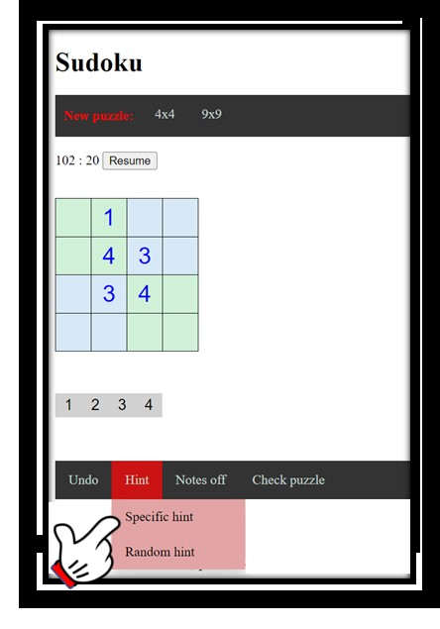
Get Specific Hint
Because hints turn non-given cells into given ones, those entries need to be removed from the stack.

Slide 17
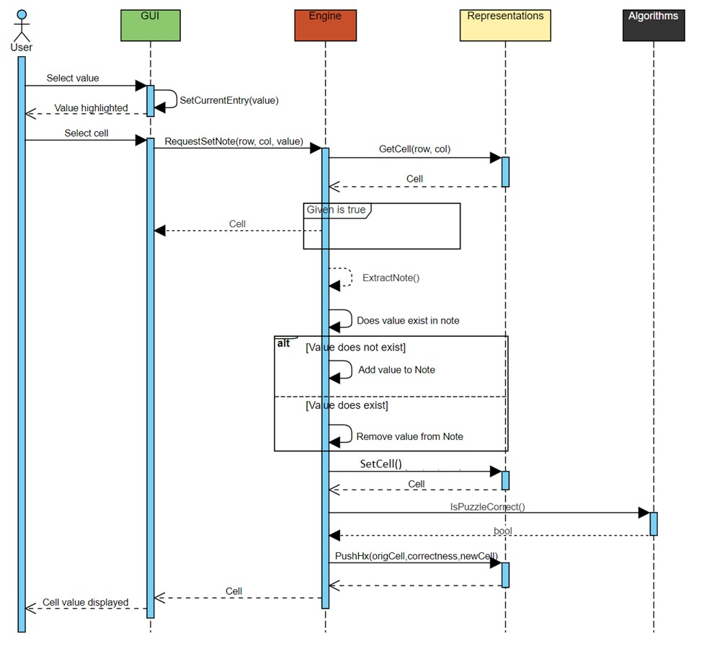
Which is better?
Returning high-level data structure
Returning low-level data structure / datum
Set Note
Check Puzzle

Slide 18
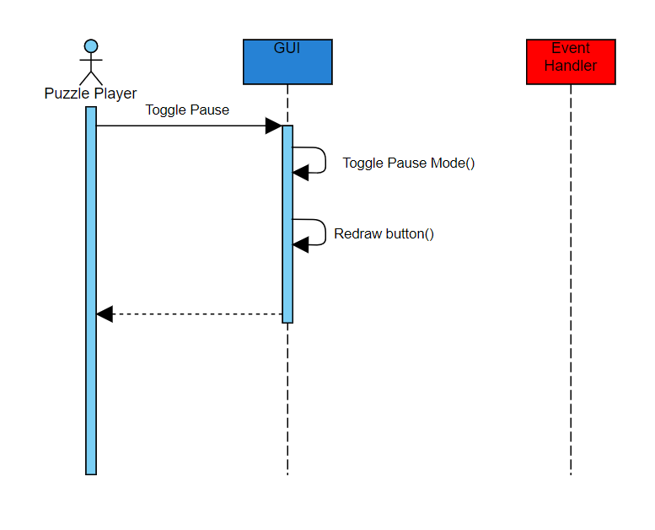
Create a sequence diagram …
Example of drawing this diagram in Visual Paradigm

Slide 19
Class Diagrams

Slide 20
Class Diagrams
Give an overview of a system by showing its classes and the relationships among them.
Class diagrams are static
They display what interacts but not what happens when they do interact
Also shows attributes and operations of each class
Good way to describe the overall architecture of system components

Slide 21
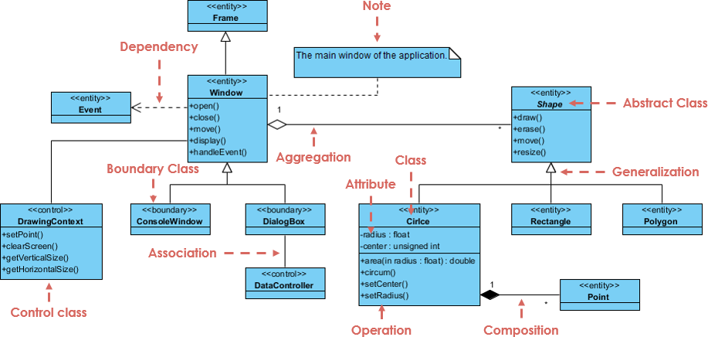
Class Diagram
https://www.visual-paradigm.com/guide/uml-unified-modeling-language/what-is-class-diagram/

Slide 22
Class Diagram
Differences between Composition and Aggregation
Composition relationship
1. When attempting to represent real-world whole-part relationships, e.g. an engine is a part of a car.
2. When the container is destroyed, the contents are also destroyed, e.g. a university and its departments.
Aggregation relationship
1. When representing a software or database relationship, e.g. car model engine ENG01 is part of a car model CM01, as the engine, ENG01, may be also part of a different car model.[8]
2. When the container is destroyed, the contents are usually not destroyed, e.g. a professor has students; when the professor dies the students do not die along with them.
Thus the aggregation relationship is often "catalog" containment to distinguish it from composition's "physical" containment.
https://en.wikipedia.org/wiki/Class_diagram
https://www.visual-paradigm.com/guide/uml-unified-modeling-language/what-is-class-diagram/

Slide 23
Example of non-OO and OO approaches
public struct PersonS
{
public DateTime DOB;
public int age;
}
int AssignAge(Person person, DateTime n)
{
int age = n.Year - person.DOB.Year;
if (n.Month < person.DOB.Month
|| (n.Month == person.DOB.Month && n.Day < person.DOB.Day))
age--;
return age;
}
Person Lucas = new PersonS();
Lucas.DOB = new DateTime(2018, 11, 16);
Lucas.age = AssignAge(Lucas, DateTime.Now);
class PersonC
{
public DateTime DOB { get; set; }
public int Age;
{
get
{
DateTime n = DateTime.Now;
int age = n.Year - DOB.Year;
if (n.Month < DOB.Month
|| (n.Month == DOB.Month && n.Day < DOB.Day))
age--;
return age;
}
}
}
PersonC Lucas= new PersonC();
Lucas.DOB = new DateTime(2018, 11, 16);
int LucasAge = Lucas.Age;
Separation of data and functions
Can have no “side-effects” (Functional programming)
Data and functions (methods) integrated (encapsulation)
Side-effects expected

Slide 24
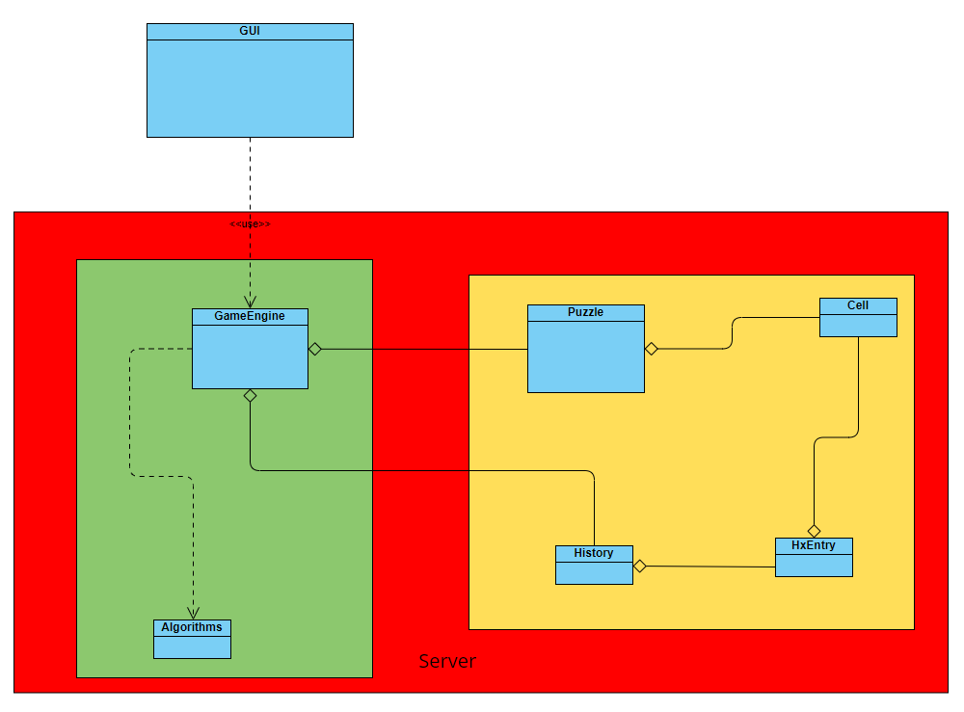
Empty
Class Diagram

Slide 25
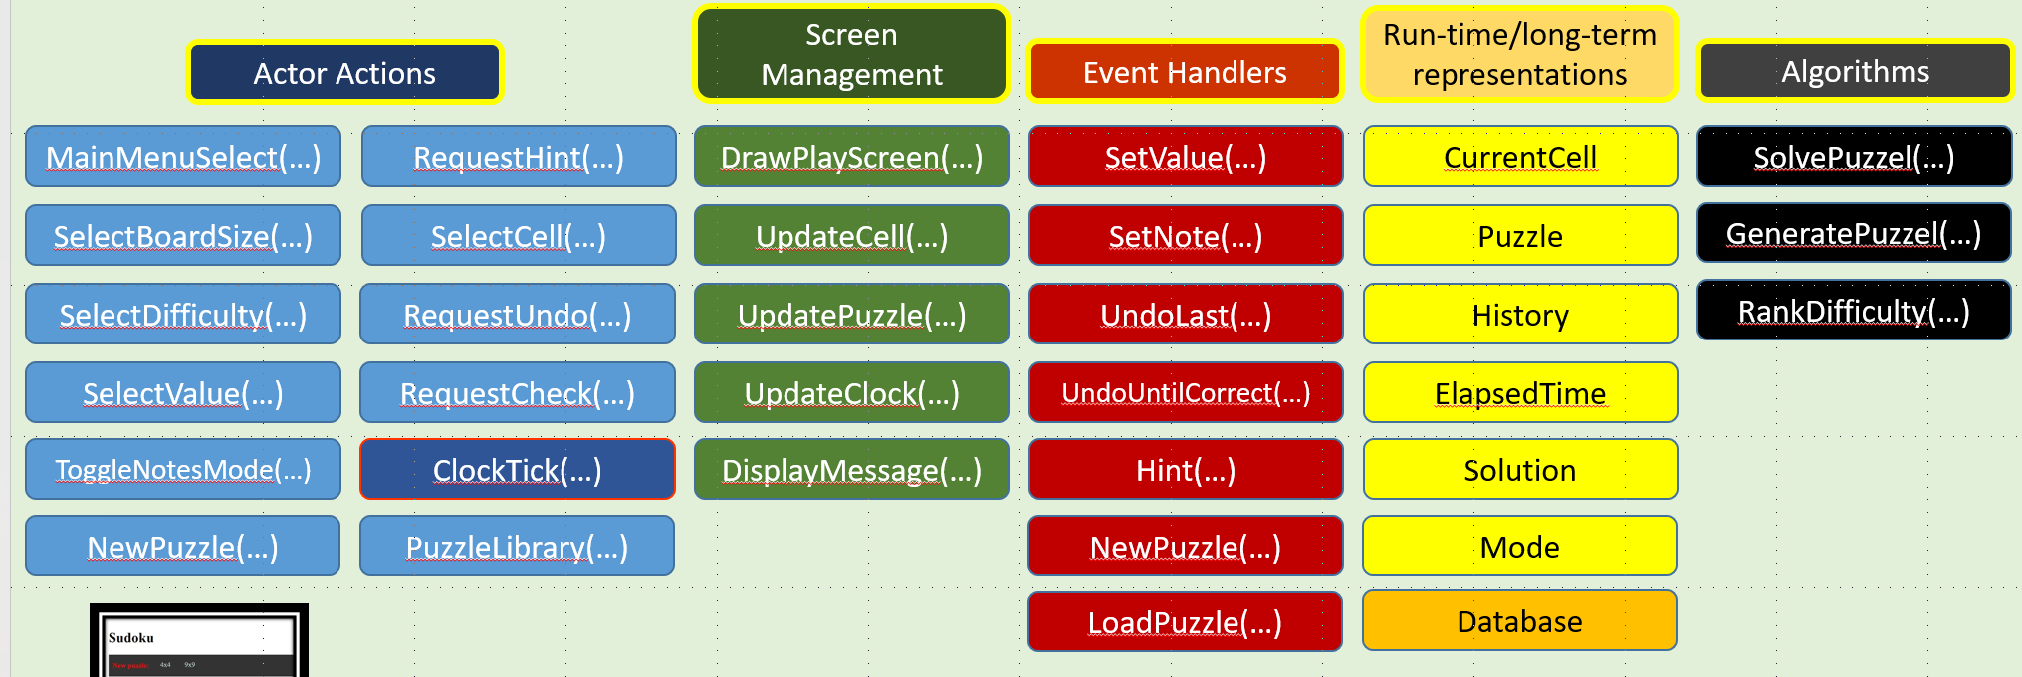
Empty
Class Diagram
Guided exercise:
As a class, fill in directly using VisualParadigm

Slide 26
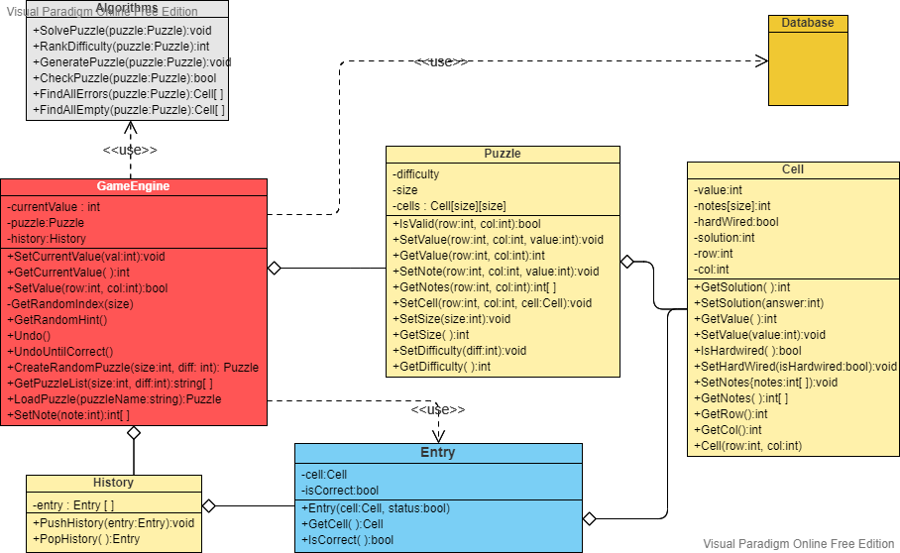

Slide 28
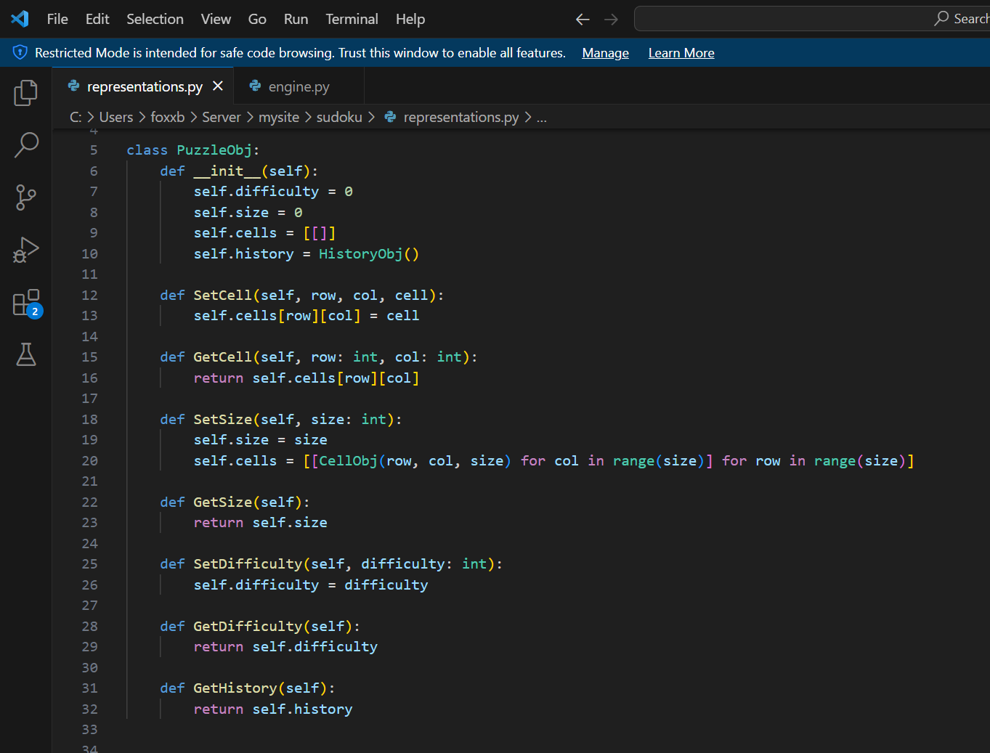

Slide 29
Activity Diagrams

Slide 30
Activity Diagrams
Fancy flowchart
Displays the flow of activities involved in a single process
States
Describe what is being processed
Indicated by boxes with rounded corners
Swim lanes
Indicates which object is responsible for what activity
Branch
Transitions that branch
Indicated by a diamond
Fork
Transition forking into parallel activities
Indicated by solid bars
Start and End
Should be easy for a competent programmer to translate into code

Slide 31
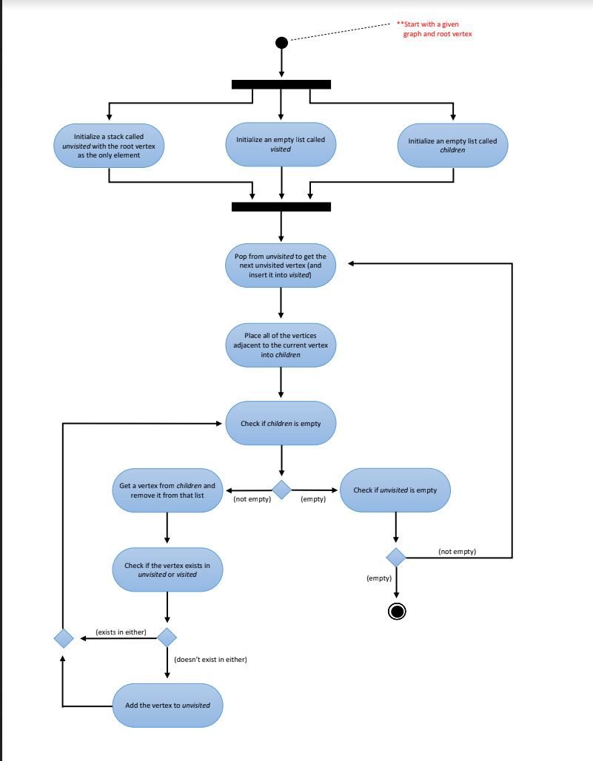
Homework
1
2
3
4
5

Slide 32
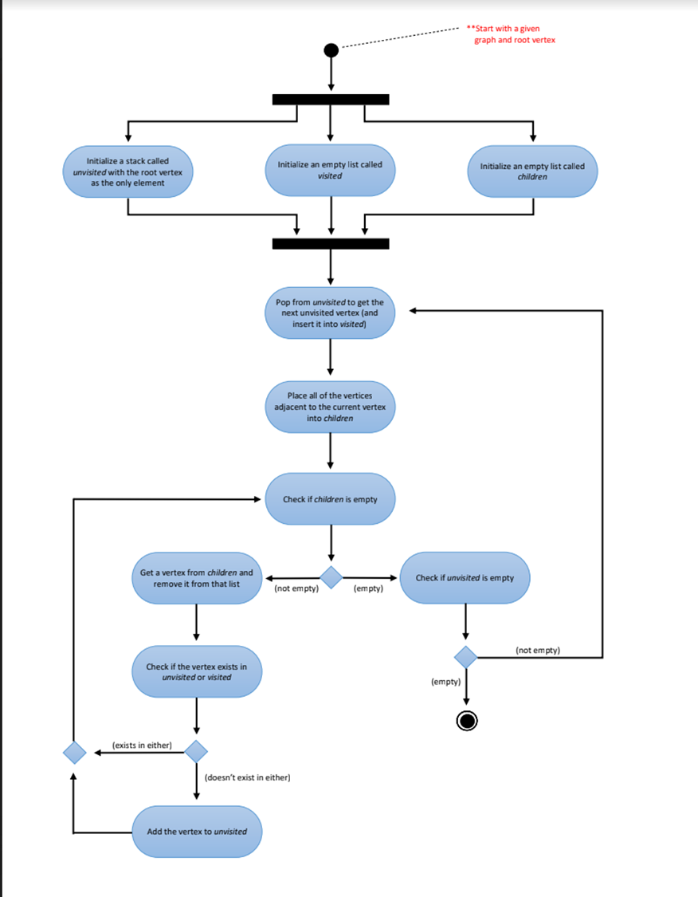
Homework
1
2
3
4
5
Unvisited
1
Visited
Children
Current =

Slide 33
Homework
Pop from Unvisited to get ‘Current’ and insert it into visited
1
2
3
4
5
Unvisited
Visited
1
Children
2, 3
Current = 1

Slide 34
Homework
1
2
Get new ‘Current’ from ‘Children’ and remove it from that list
3
4
5
Unvisited
2
Visited
1
Children
2, 3
Current = 2

Slide 35
1
2
3
4
5
Unvisited
2
Visited
1
Children
2, 3
Current = 2

Slide 36
Homework
1
2
Get new ‘Current’ from ‘Children’ and remove it from that list
3
4
5
Unvisited
Visited
1, 3, 5, 4, 2
Children
2, 3, 1, 4, 5, 3, 4, 3, 5
Current = 2

Slide 37
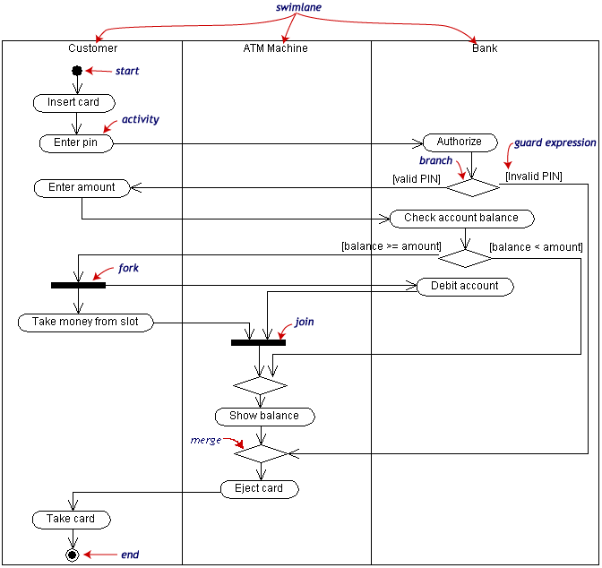
Activity Diagram Example

Slide 38
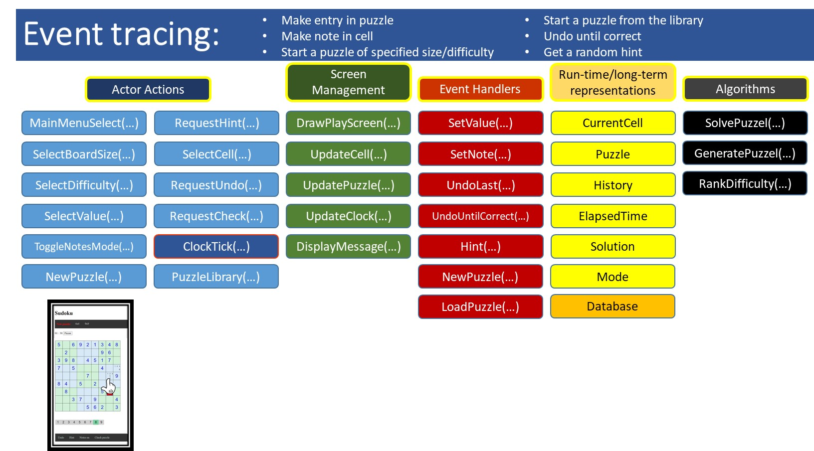
Create an activity diagram …
You will start this exercise as a team, but for homework each individual should complete the task.
In class:
Get the idea of how to draw
Get far enough to ask questions
For homework:
Complete diagram
Enter into a drawing tool
Create a UML activity diagram for:
Team Azerbaijan, D: Get random hint
Team B,E: Fix history stack
Team C,F: Solve puzzle

Slide 39
Create an activity diagram …
Create a UML activity diagram for:
Team Azerbaijan, D: Get random hint
Team B,E: Fix history stack
Team C,F: Solve puzzle
Get Random Hint
Find all player supplied entries are incorrect
If any exist:
Randomly choose one
Correct that cell
Fix the history stack
Else
Find all unassigned cells
If any exist:
Randomly choose one
Assign correct value to that cell
Fix the history stack
Else
Do nothing???
Return updated cell
Fix History Stack
Create a second history stack
Pop original stack
If entry is for location where the hint was given, discard it
Else push entry onto second stack
Repeat steps 2 – 4 until original stack is empty
Pop all elements from second stack and push them onto original stack
For each one rebuild the puzzle with the ‘new’ part of the history entry

Slide 40
Create an activity diagram …
Create a UML activity diagram for:
Team Azerbaijan, D: Get random hint
Team B,E: Fix history stack
Team C,F: Solve puzzle
Solve Puzzle
Choose between a heuristic approach or a brute force approach
Loop over whole grid
For each cell
Loop over legal values (e.g. 1 -9)
See if value already exist in row, col, or sub-group
If yes go to next value
If no, assign that value
If no values work, backtrack to previous cell and increment

Slide 41
Homework

Slide 42
Homework
Enter your sequence diagram into a drawing tool
Enter your algorithm into a drawing tool
Class diagram – due in two weeks
See next page for details
Reading
Chapter 10 through 10.3.1 inclusive (architecture)

Slide 43
Choose a team member* to create a class diagram and populate it with input from other team members
Create a class diagram similar to the one shown here, but for your project
For each class fill in:
Attributes with types
Methods with parameters and return types
* From here on out you should have one team member be the keeper of specific documents. This person is only the ‘scribe,’ not the person solely responsible for its contents. Such documents include:
Class diagram
Project plan
Source code control system (GitHub)
…

Slide 44
Core principles
(from chapter 6 in our book)

Slide 45
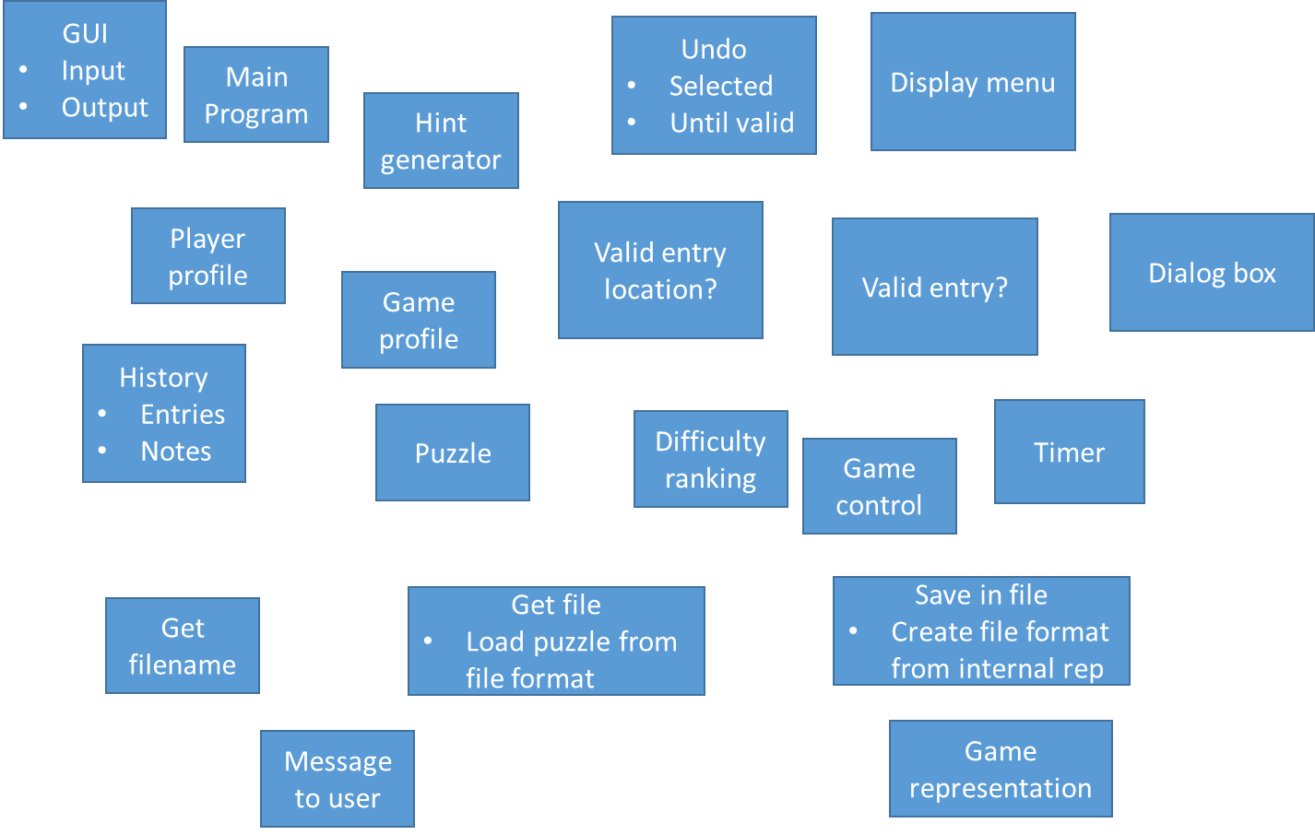
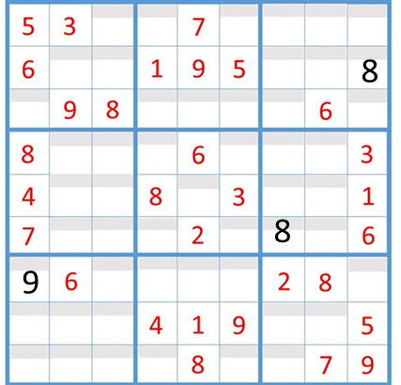
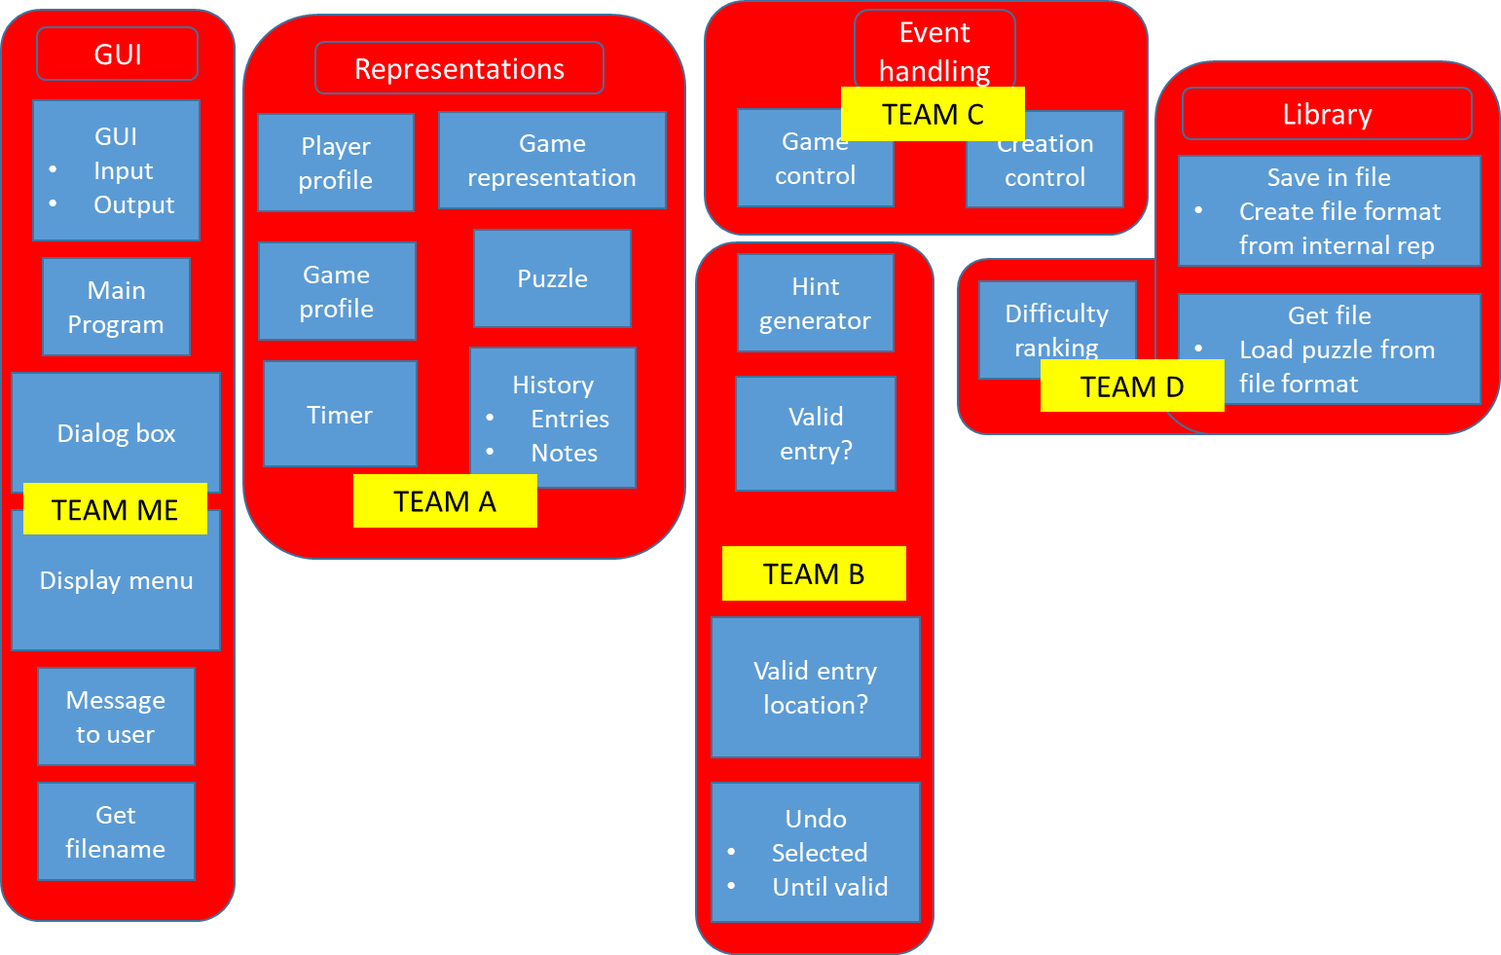
Core principles
Divide and conquer
Abstraction
3 4 7
A matrix of tiles with option of notes or values

Slide 46
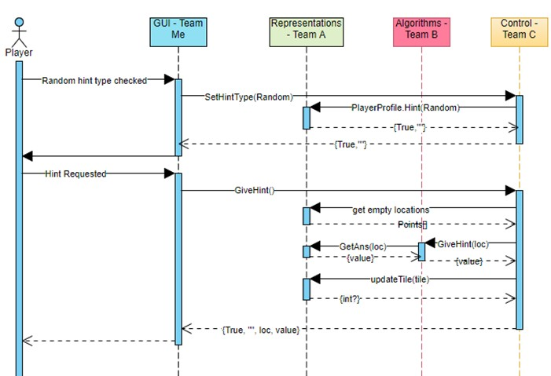
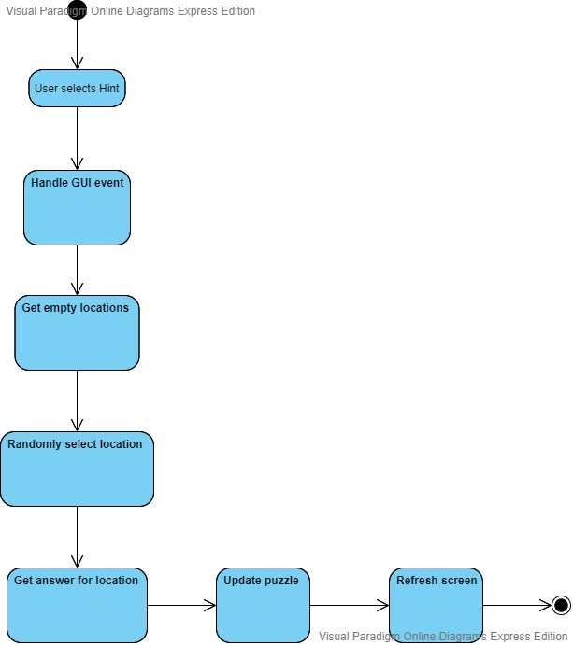
Core principles
Focus on the transfer of information
Build software that exhibits effective modularity
“Modularity must be effective. That is, each module should focus exclusively on one well-constrained aspect of the system—it should be cohesive in its function and/or constrained in the content it represents.”

Slide 47
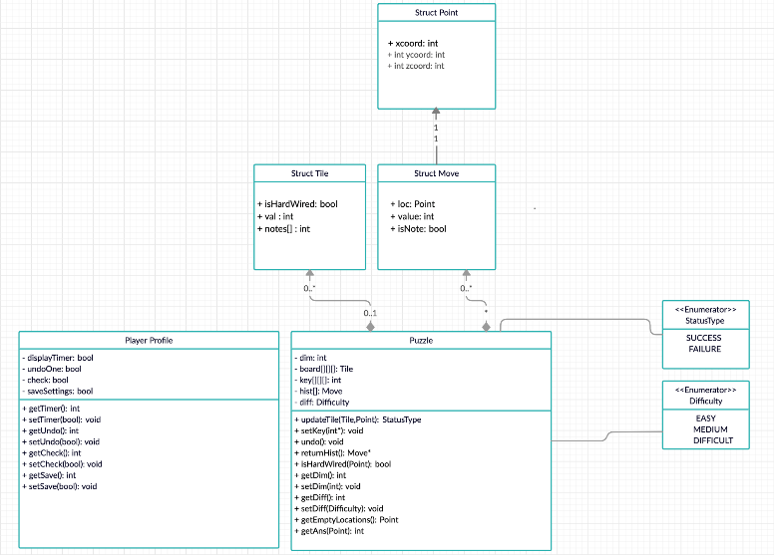
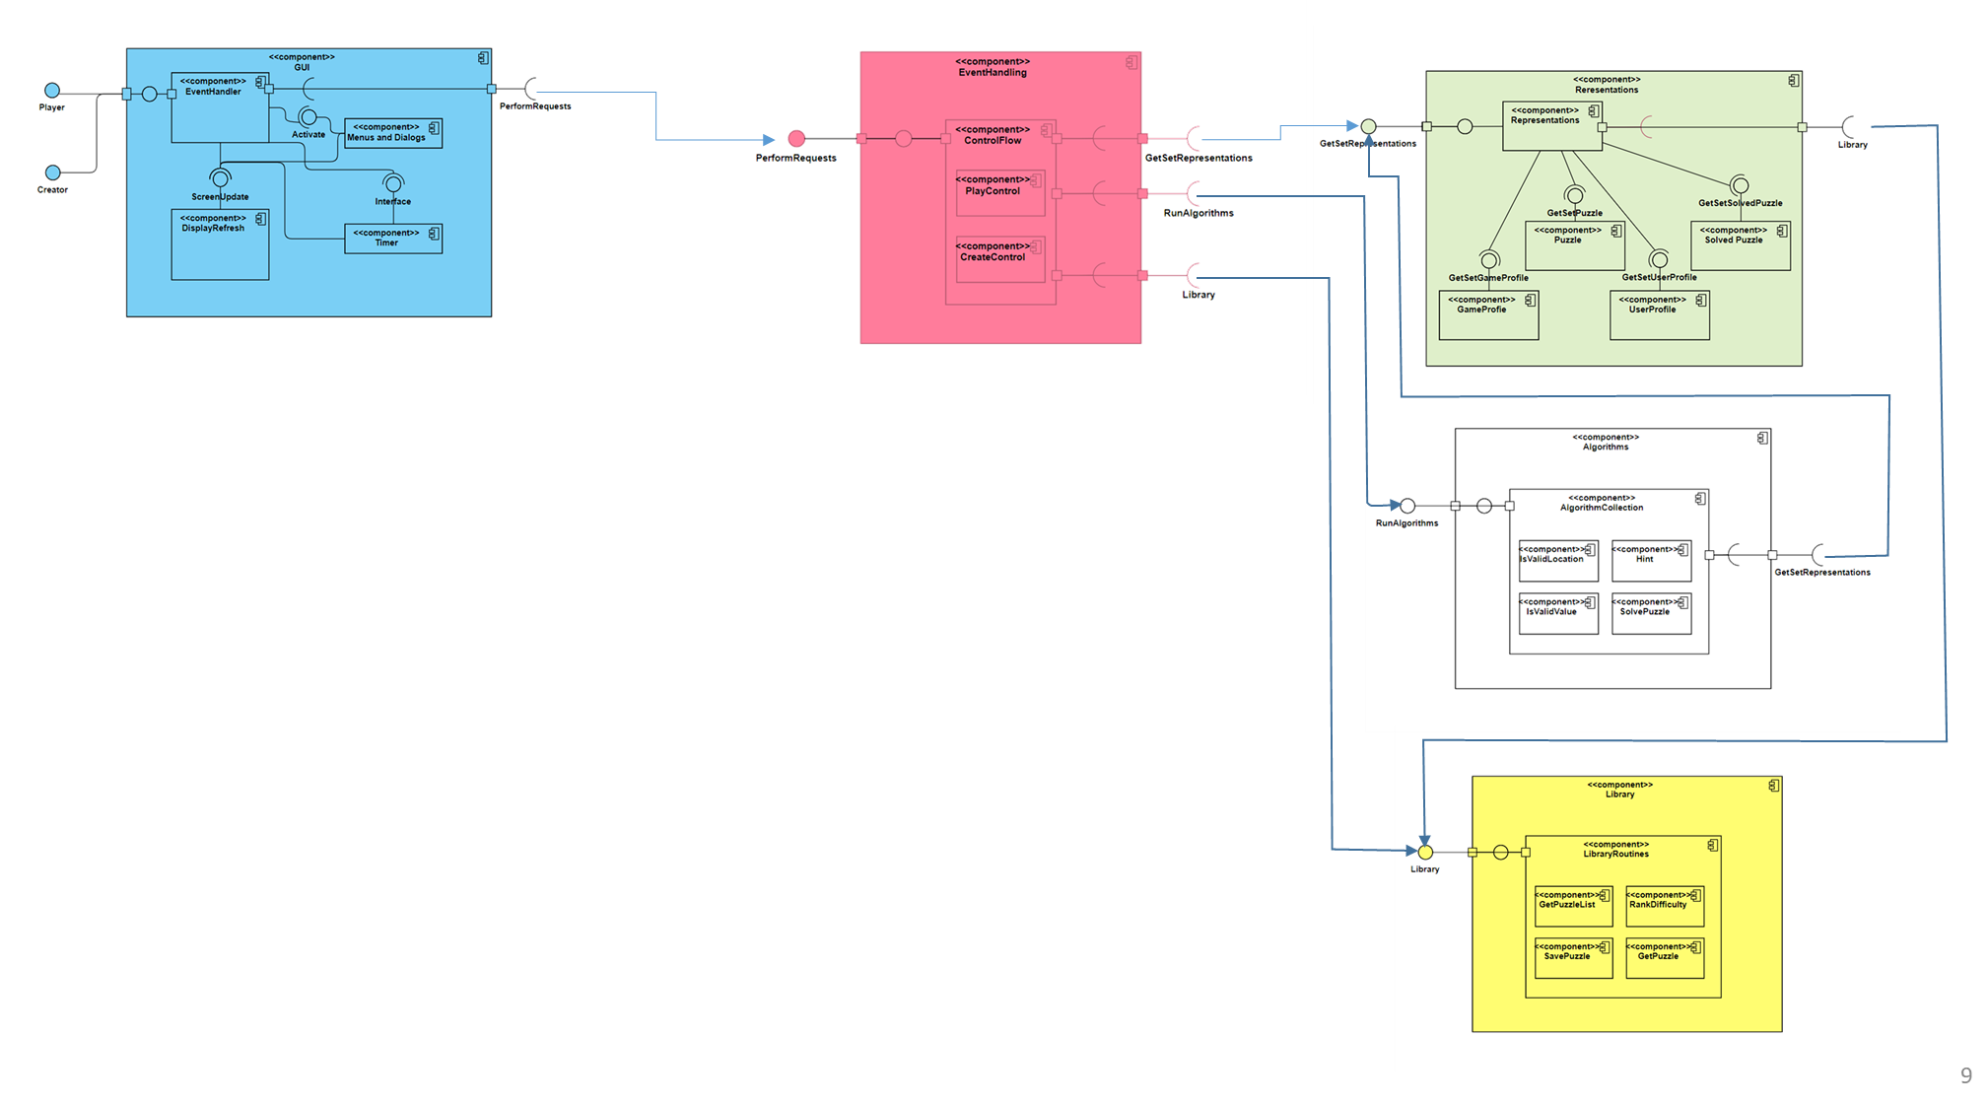

Core principles
Look for patterns, E.g.:
Undo
Undo until correct
Give hint at selected location
Give hint at a random location
User creates a puzzle
A puzzle from a library is loaded
Creating an answer key
Is a puzzle being created solvable?
Does a puzzle have a unique solution?
When possible, represent the problem and its solutions from a number of different perspectives

Slide 48
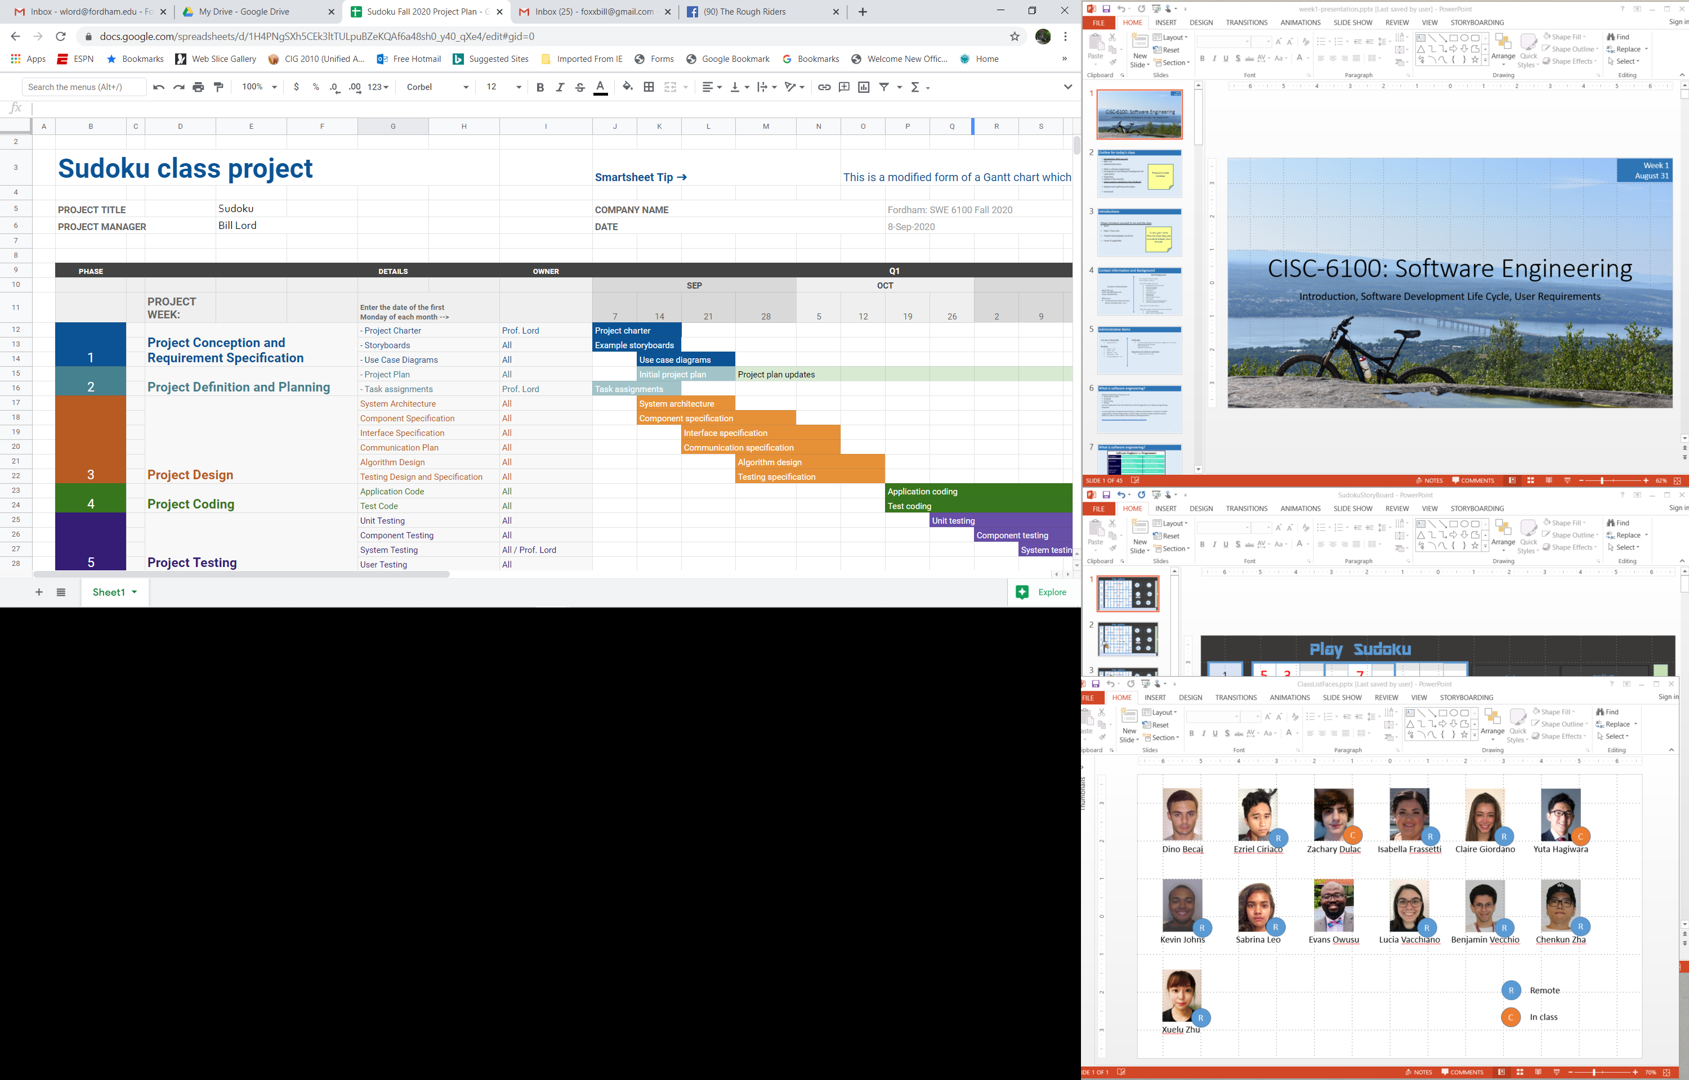
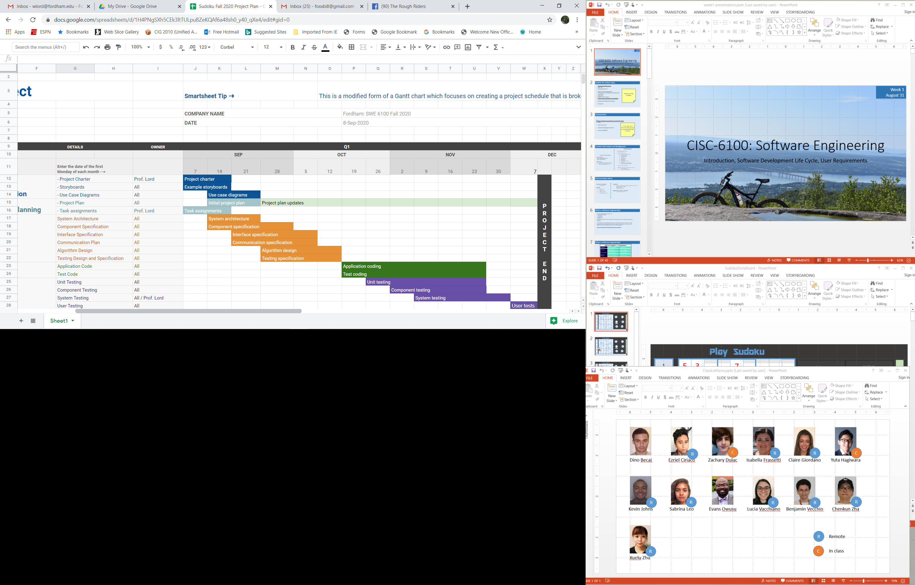
Core principles
Remember that someone will maintain the software
Adjust granularity as you define the plan/design

Slide 49
Core principles
Design of data is as important as design of processing

Slide 50
Extras

